Slide 1
Topic 7 - Infrastructure as a Service (IaaS) Providers
Exploring Features, Technologies, and Leading Providers

Slide 2
Introduction to IaaS
Infrastructure as a Service (IaaS) is a form of cloud computing that provides virtualized computing resources over the internet. With IaaS, businesses can rent servers, storage, and networking infrastructure on-demand, rather than owning and maintaining physical data centers. It provides maximum control over operating systems, storage, and deployed applications, making it ideal for system administrators and developers.
This model lays the foundation for understanding how modern cloud infrastructures are structured and consumed, leading into a comparison with other cloud service models.

Slide 3
IaaS in Cloud Models
IaaS is one of the three main cloud service models: IaaS, PaaS, and SaaS. It offers the highest level of flexibility and management control.
Understanding IaaS's position helps us appreciate the unique features that make it suitable for specific use cases, which we will now explore.

Slide 4
Key Features of IaaS
On-demand Self-Service: Users can provision resources as needed.
Resource Pooling: Providers pool computing resources to serve multiple clients.
Rapid Elasticity: Scale resources up or down quickly.
Measured Service: Pay only for what you use. These features enable agility and cost-efficiency.

Slide 5
Elasticity and Scalability
Elasticity refers to the ability of a system to automatically scale in or out depending on demand. For example, during a major sales event, an e-commerce site can automatically add servers to handle increased traffic, and reduce them once traffic returns to normal—ensuring cost optimization and performance stability.
To enable this kind of flexibility, IaaS depends heavily on virtualization.

Slide 6
Virtualization Technology
IaaS heavily relies on virtualization to abstract hardware resources. Virtual machines (VMs) are created on physical servers using hypervisors such as VMware ESXi, Xen, KVM, or Hyper-V. This enables multiple users to share the same physical hardware securely and efficiently, reducing hardware costs and improving scalability.
Since IaaS infrastructure spans the globe, let’s now look at the importance of where this infrastructure is physically located.

Slide 7
Geographic Presence
Most IaaS providers have a global network of data centers. These are grouped into geographic regions and availability zones. The wider the presence, the more options a business has to place data closer to users—reducing latency and meeting data residency laws.
But having global data centers alone isn’t enough—strategic placement plays a crucial role, as we’ll now see.

Slide 8
Importance of Data Center Location
Choosing a data center location is crucial for performance and compliance. For instance, a company targeting Asian customers might choose a Singapore or Tokyo region. Data locality also affects legal compliance, e.g., GDPR compliance in Europe.
Once a location is selected, users need methods to interact with and manage their infrastructure.

Slide 9
User Interfaces and Access to Servers
Web-based dashboards (e.g., AWS Management Console)
Command-line tools (e.g., Azure CLI, AWS CLI)
RESTful APIs and SDKs for automation This variety ensures accessibility for both beginners and advanced users.

Slide 10
Interfaces in Practice
For example, DevOps teams often use APIs or tools like Terraform to automatically create and manage infrastructure as code. This automation improves consistency and reduces human error in large deployments.
Let’s now consider how some businesses plan ahead and save costs through capacity reservation.

Slide 11
Advanced Reservation of Capacity
IaaS providers often offer reserved instances at a lower cost compared to on-demand instances. This is useful when you have predictable workloads. For instance, a business with a steady monthly traffic pattern can reserve capacity in advance and save up to 70%.
To see how this works in practice, consider a real-world academic use case.

Slide 12
Real-World Example of Reservation
Imagine a university hosting an exam portal every semester. Since they know the exact dates of high usage, they can reserve capacity in advance, ensuring both cost savings and availability.
But what happens when usage patterns are unpredictable? That’s where auto scaling and load balancing come in.

Slide 13
Auto Scaling and Load Balancing
Auto Scaling automatically adjusts the number of VM instances to meet demand. Load Balancing distributes traffic evenly across instances. Together, they ensure high availability, fault tolerance, and cost efficiency during variable load conditions.
This is especially crucial for applications facing sudden traffic spikes, like e-commerce websites.

Slide 14
E-commerce Example
During flash sales, a fashion website may receive traffic spikes. Auto scaling adds more servers to handle the surge, and the load balancer routes users across these servers to prevent crashes, ensuring a smooth customer experience.
To guarantee performance, these services are backed by formal agreements known as SLAs.

Slide 15
Understanding SLAs
Service-Level Agreements define the expected level of service, typically including uptime (e.g., 99.99%), response times, and support levels. SLAs build trust and set accountability between provider and customer. Breaching SLAs may result in service credits.
The implications of these agreements are significant—especially for mission-critical applications.

Slide 16
SLA Implications
If a provider promises 99.99% uptime, this means only about 52 minutes of downtime per year is acceptable. Applications requiring high availability, like online banking, must evaluate SLAs critically before choosing a provider.
Underpinning these performance commitments is the technology that manages VMs—hypervisors.

Slide 17
Hypervisors Overview
Hypervisors manage VMs and are classified into:
Type 1: Bare-metal (e.g., Xen, VMware ESXi)
Type 2: Hosted (e.g., VirtualBox) Type 1 hypervisors are more secure and commonly used in data centers. AWS uses a customized version of Xen and Nitro.
Hypervisors enable the use of multiple operating systems.

Slide 18
Operating System Choices
Users can install any OS, such as Ubuntu, CentOS, Red Hat, or Windows Server. This flexibility supports a wide variety of use cases—from hosting websites on Linux to running legacy enterprise apps on Windows.
Now that we understand the core technology, let's examine the major players offering these services.

Slide 19
Introduction to IaaS Providers
Several key players dominate the IaaS space, each with unique strengths:
Amazon Web Services (AWS)
Flexiscale
Joyent
Rackspace We’ll now explore each in more detail to compare what they bring to the table.

Slide 20

Amazon Web Services (AWS)
AWS is the largest and most widely used IaaS provider. It offers a vast array of services beyond compute and storage, including AI, IoT, and big data analytics. AWS supports global infrastructure with 30+ geographic regions.
Let’s take a closer look at one of AWS's flagship IaaS offerings—Amazon EC2.

Slide 21
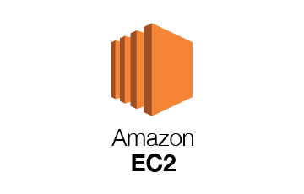
Amazon EC2 Features
Elastic Compute Cloud (EC2) allows you to launch virtual servers on-demand. Features include:
Variety of instance types (General, Compute, GPU)
Elastic IPs
AMIs (Amazon Machine Images)
Integration with Auto Scaling, ELB, CloudWatch

Slide 22
EC2 Use Cases
A startup can launch a web app with minimal upfront cost.
Research teams can run machine learning models on spot instances.
Enterprises can deploy scalable microservices architecture.
Beyond AWS, there are other notable providers with unique features worth examining.

Slide 23
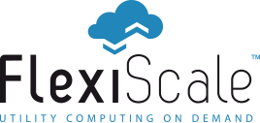
Flexiscale Overview
Flexiscale was among the first cloud IaaS platforms. It emphasized ease of use, GUI-based management, and real-time provisioning. It laid the groundwork for future European cloud innovations.

Slide 24
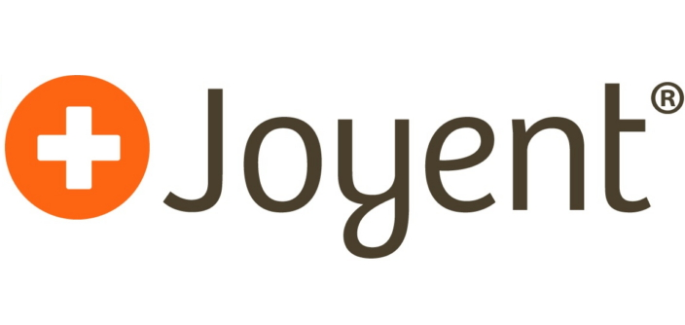
Joyent Overview
Joyent provides SmartOS-based virtual machines optimized for real-time apps. Known for supporting Node.js early, Joyent is now part of Samsung and focuses on cloud-native workloads and high-performance computing.

Slide 25
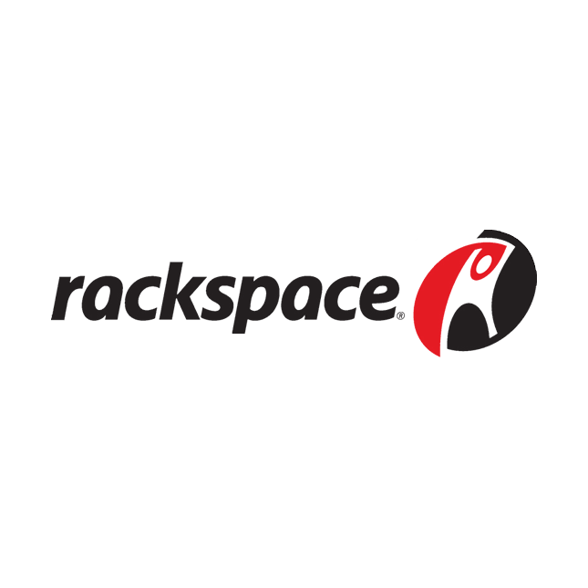
Rackspace Cloud Servers
Rackspace specializes in managed cloud services. It helps businesses deploy and manage cloud infrastructure on platforms like AWS, Azure, and Google Cloud. Their focus is on customer support, making them ideal for companies with limited IT staff.

Slide 26
Comparing Providers
Feature | AWS | Flexiscale | Joyent | Rackspace
Global Reach | High | Low | Moderate | High
Support | Good | Moderate | Developer-focused | High-touch
Pricing Flexibility | High | Medium | Medium | Low
OS Flexibility | Broad | Broad | SmartOS | Broad

Slide 27
Choosing the Right IaaS
Cost predictability
Performance and availability needs
Compliance requirements
In-house expertise A healthcare startup might choose AWS for scalability, while a small firm might pick Rackspace for its support.

Slide 28
Real-World Applications of IaaS
Education: Virtual labs, student VMs
E-commerce: Scalable web stores
Media: Video rendering farms
Government: Secure data processing These use cases highlight the flexibility of IaaS across sectors.

Slide 29
Challenges with IaaS
Cost overruns without monitoring
Data security risks if misconfigured
Vendor lock-in
Complexity in setup and scaling These should be planned for during adoption.

